Slide 1
Sizzle Awards
Template and Example
This PowerPoint contains a template, along with one entry example. Delete the instructions from the template to create your own presentation,
and employ the example as a guide.

Slide 2
Each entry must have the following four types of slides. Use the exact same font, color, size, positioning, and order shown in the examples to maintain consistency across entries.
Title Slide – Input the client company name (i.e., the exhibiting company), along with the category, show name, year, and budget range.
Photo Slides – Include overall and detail images of the completed project. While renderings will be accepted, two to 20 images of the completed project must be included. These photos should be identical to the high-res images submitted as individual files via DropBox. Only one blank slide is included in each template, so copy and paste as necessary to accommodate your photos.
Use one image per slide on a solid black background. Although not required, MINIMAL text (a few words to one short sentence) may be included in white (Font: calibri 18) to describe an image.
If you provide video(s) (which are optional), write “video” on a blank slide. We will then embed your video into the proper slide after you submit your materials via DropBox.
3. Written Summary Slide(s) – Provide a written description of the project. You may add slides as necessary to accommodate your text; however, always maintain the font type, size, color, positioning, and order.
4. Contact Info – List the creative firm(s), production firm(s), and photography firm(s). This is the only slide where names of firms should be mentioned.

Slide 3
The next four slides are the template. To create your own presentation(s) using the template, either:
a) Copy slides 4-7 to a new document (being sure to save the existing formatting/theme), delete the instructions from each slide, and add your text and photos,
OR
b) Save and rename this entire document. Then delete the introductory slides (Nos. 1-3) as well as the example at the end. Finally, remove the instructions from each slide and add your text and photos.

Slide 4
Client Company Name
(Font: Calibri 54, white)
Category: (Which category are you entering?)
Show: (Spell out the full name of the show or the name of the virtual/online event. Don’t use acronyms.)
Year: (Identify the year the show took place.)
Budget: (Input the budget range you selected when completing the online form. Use this format: $75 – $99K. Also note that all budget ranges and category names appear on the Submission Instructions for your reference.)
(Font: Calibri 18, white)

Slide 5
Paste one image per slide.
Add additional blank slides as necessary. Although not required,
MINIMAL white text in Calibri 18 may be used to describe an image.
If you include optional videos with your entry, please place the word “video” on a blank slide
and include the actual video file among your high-res images submitted via DropBox.
Once we receive your materials and start to organize all entries,
we will embed the video file(s) into the labeled slide(s).
(Remove this text box before pasting each photo.)

Slide 6
Client Company Name (Font: Calibri 29, white)
Company: (Use 10 words or fewer to describe the client company.) (Font: Calibri 18, white)
Target Audience: (Briefly describe the target audience for this promotion.) (Font: Calibri 18, white)
Goals:
(Use paragraphs or bulleted points to describe the promotion’s measurable, numeric objectives, such as leads, ROI, sales, attendance, press mentions, etc.) (Font: Calibri 18, white)
Project Description/Solution:
(Use paragraphs or bulleted points to describe the promotion in detail.) (Font: Calibri 18, white)
Results:
(Provide numeric results relative to the stated goals, such as leads, ROI, sales, attendance, press mentions, etc. Information must include comparisons that give the results a context. For example, include year-to-year or results-to-goals comparisons.) (Font: Calibri 18, white)
(You may split this information onto several slides if necessary. Just be sure to maintain the headings and design to aid content organization, and remember that in the eyes of the judges, concise, concrete, and well-written text is better than multiple slides filled with verbose marketing-speak.)
(NAMES OF CREATIVE OR PRODUCTION FIRMS SHOULD ONLY APPEAR ON THE CONTRIBUTING FIRMS SLIDE.)

Slide 7
Contributing Firms (Font: Calibri 29, white)
(Use bullet points to list all firms involved in the design, fabrication, and photography of the exhibit, along with a contact person, phone number, and email for each.)
(Font: Calibri 18, white)
Creative
X
Production
X
Photography (List the company, not person, that should receive the photo credit.)
X
(All firms listed must fall under one or more of these headings. That is, categories such as AV design, lighting concepts, etc. are not allowed.)

Slide 8
The remaining slides provide an example to illustrate how your entry should look and what type of information the judges are expecting in the summary.

Slide 9
Micron
Category: Premium/Giveaway
Show: VM World
Year: 2019
Budget: Less Than $49K

Slide 10
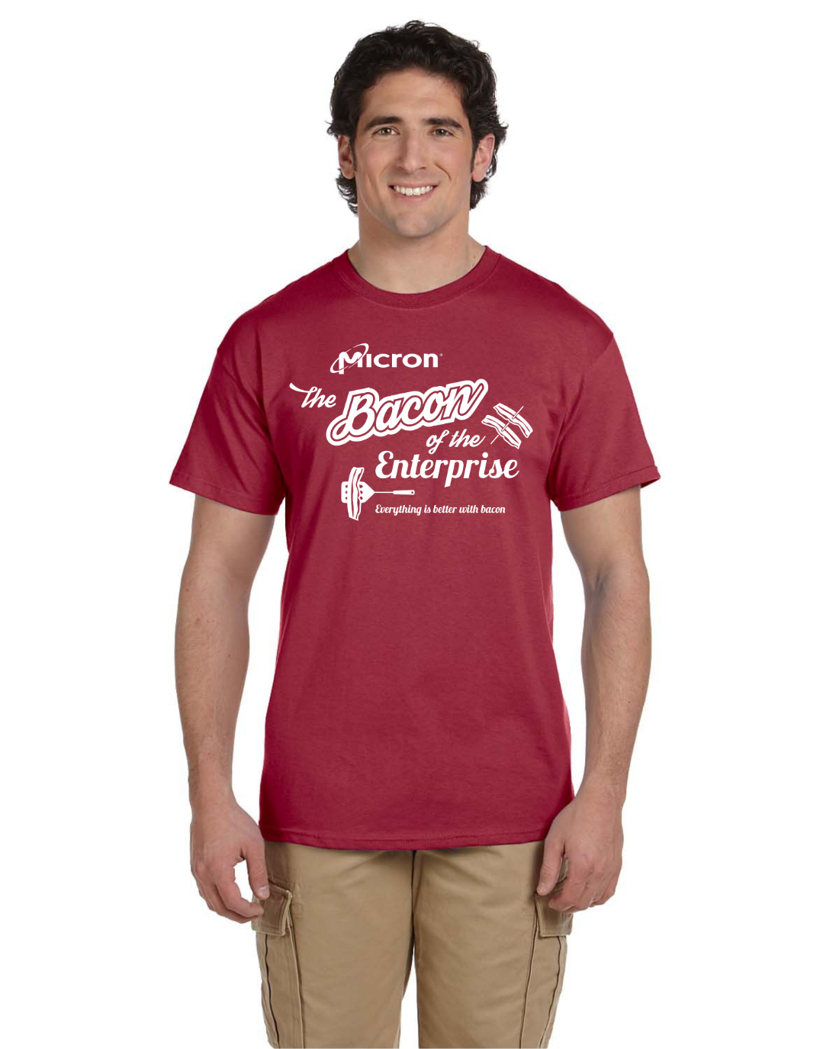

Slide 11
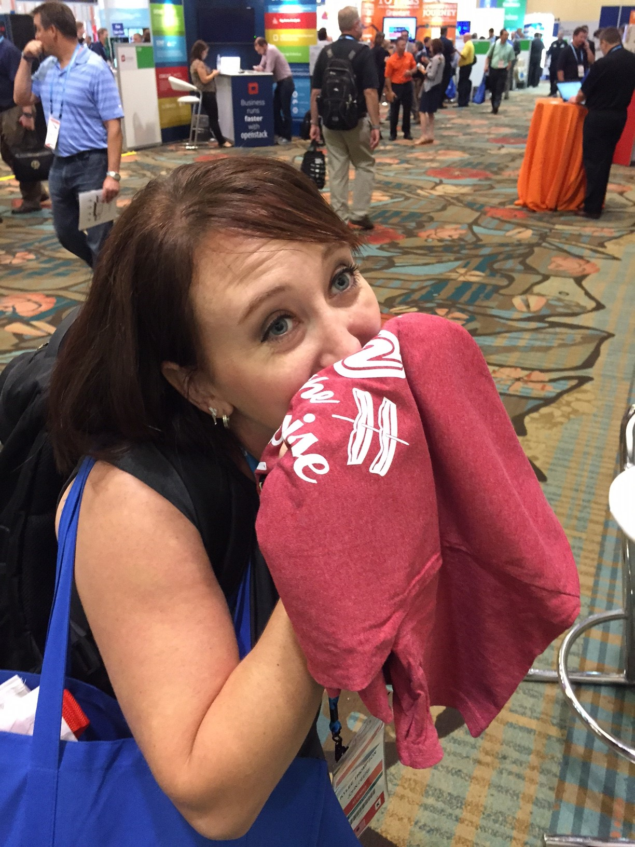

Slide 12
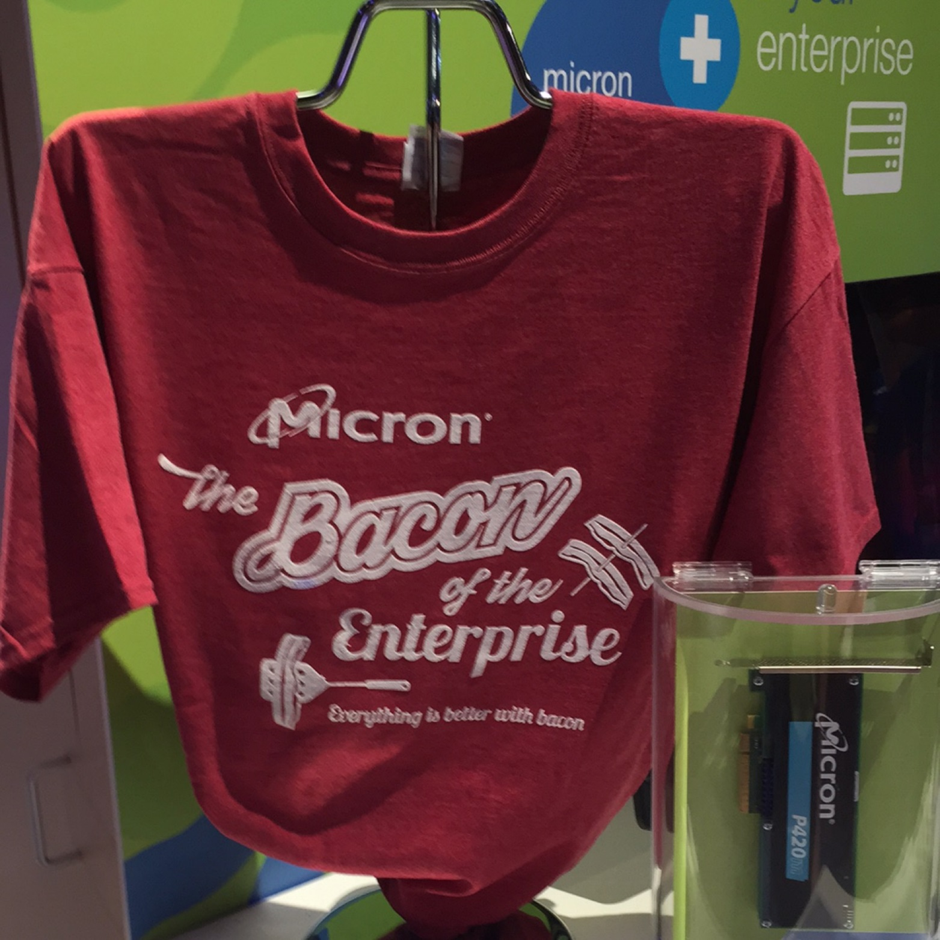

Slide 13


Slide 14


Slide 15
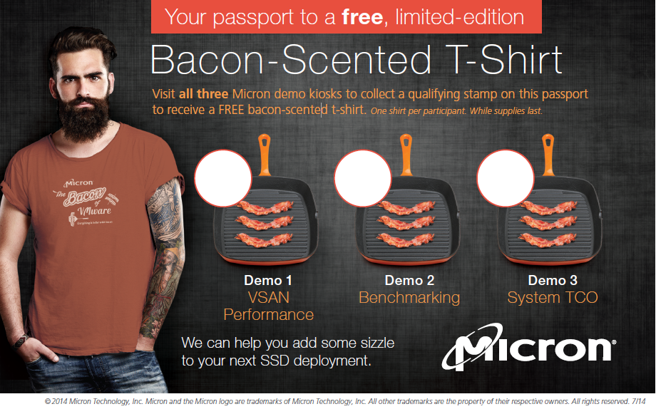

Slide 16
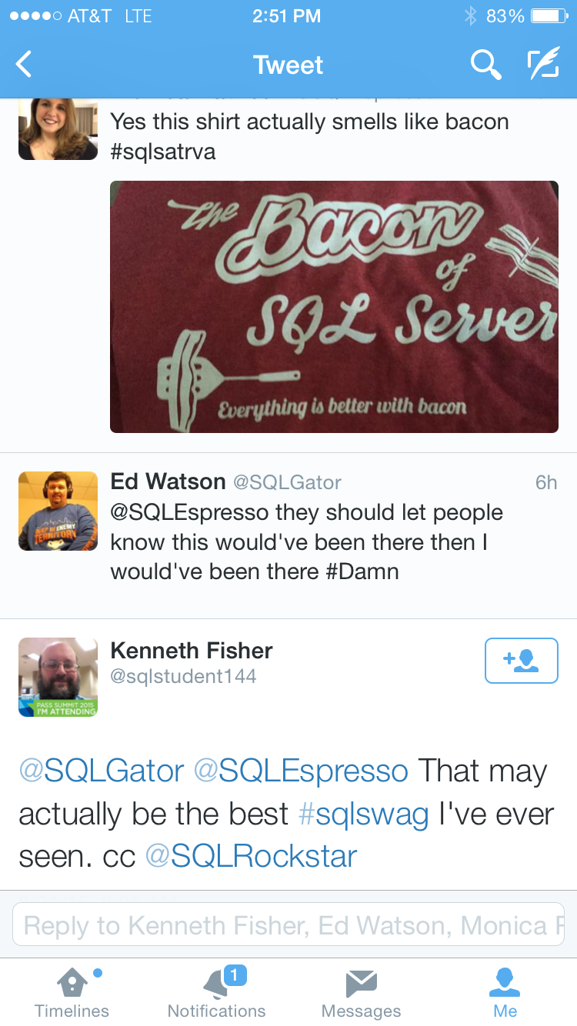
At-Show Tweets

Slide 17
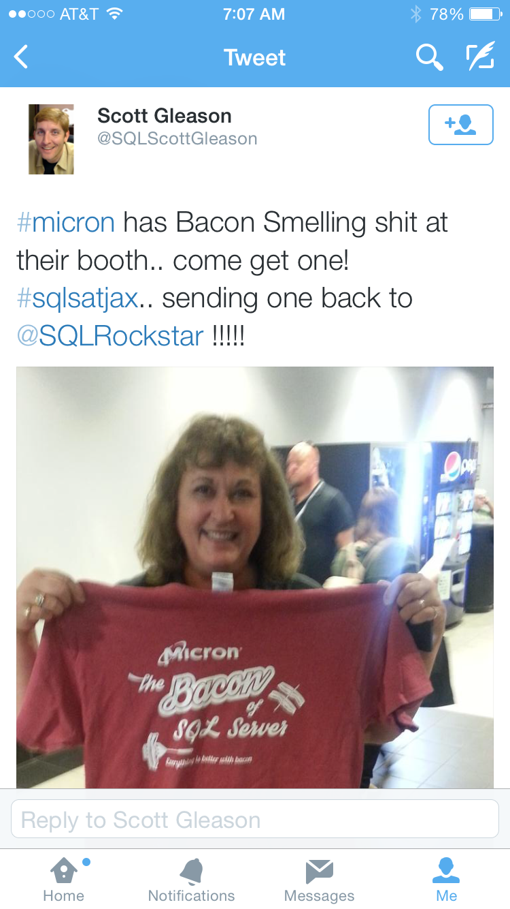

Slide 18
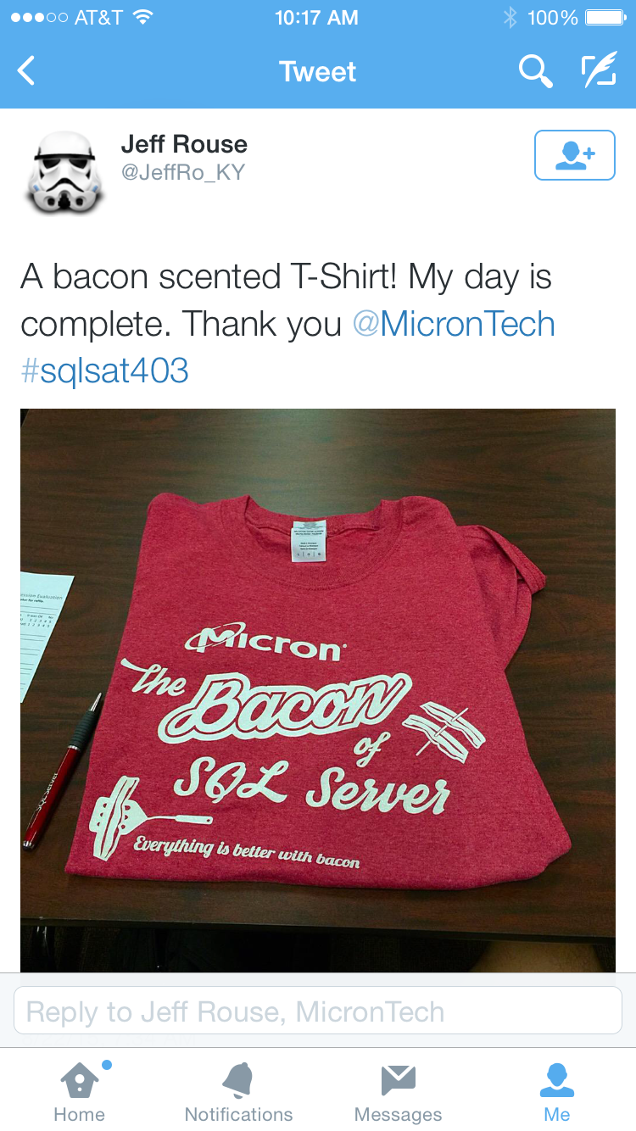

Slide 19
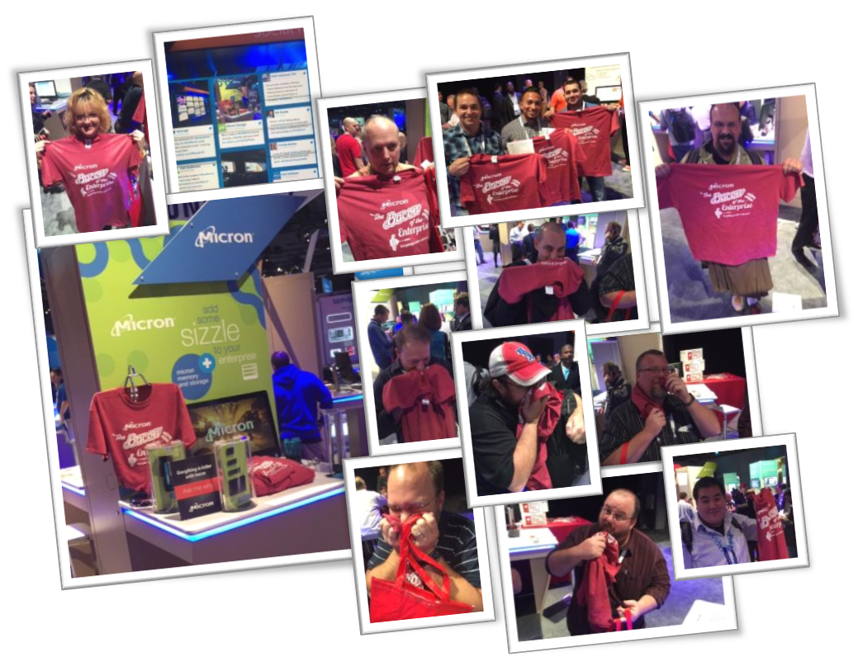

Slide 20
Micron
Company: Micron is a global leader in semiconductor memory storage solutions. This promotion started at VMworld, August 24-28, 2019, San Francisco, CA – Moscone Center, but ran through May 4-7, 2019 at Microsoft Ignite in Chicago.
Target Audience: Technical Influencers and Technical Decision makers in the IT community, specifically database administrators specializing in virtualization. The promotional giveaway focused on this audience’s love of bacon. There is even a vBacon party at the show, so we wanted to draft off of that love.
Goals
Increase scanned leads over 2018 by 50%
Increase attendance time in booth to >5 min/attendee
Gain press & social media mentions – none in 2018
Project Description/Solution
Faced with the challenge of getting noticed at enterprise storage trade shows, we were looking for an innovative giveaway that would bring people to our booth and want to stick around to hear our message. The IT community that belongs to Spiceworks (www.spiceworks.com) was our typical audience. Looking at some of their user participation contests, we found that bacon was a huge draw (e.g. participate in this survey and get a pound of bacon). It was getting bigger participation vs. surveys that had consumer electronics as prizes.

Slide 21
Micron
Project Description/Solution:
Because of health and food safety laws, we couldn’t cook bacon in our booth, but we still wanted to have the allure of bacon. There were a lot of bacon related swag, so we had to be unique.
We came up with catchphrase “Micron – The Bacon of VMware” (at subsequent events we changed it to Micron – The Bacon of the Enterprise, so it wasn’t show specific). This way we could say that “Much like bacon makes everything taste better, we make VMware run better with our flash technology. Let me show you…”
We found a clothing scent manufacturer –Durascent – that produces scents that can be silkscreened on to textiles, and a silkscreen shop in Tennessee NDesigns (ndesigns.com) that could do bacon scented silk screening. We were fortunate that there were no qualified Durascent distributors west of the Mississippi, so being based our West, we thought we had a pretty unique giveaway.
Our in-house graphic designer came up with the t-shirt design. We wanted it to be 1 color, 1 location to keep the cost down. Also to keep costs & inventory down, we just had the shirts in 2 sizes – Large & XL. Reason being is we really didn’t expect people to wear the shirts, we wanted them to hang in their office, or show off to friends.

Slide 22
Micron
Project Description/Solution:
Initial shirt design at VMworld was Burnt Orange with an 8” imprint. Once we sawhow successful the theme was, we went with a Heathered Cardinal shirt (to look more like bacon) and increased the imprint to 11”. The larger imprint provided more bacon scent.
We extended the booth theme with “Add some sizzle to your server” as the main tagline, and produced a bacon themed passport for people to go to all the demos and complete before they received a shirt.
For a booth raffle, we also gave out 3 month “Bacon of the Month Club” memberships from BaconFreak.com. This premium allowed us to reconnect with the lead every 30 days and associated Micron with their love of bacon.
We really started an underground following with these t-shirts. Attached in the PowerPoint presentation are samples of unsolicited tweets raving about them.
The real fun with these shirts was the delight from people when they received them. They didn’t expected it to actually smell like bacon, the surprised reaction was priceless

Slide 23
Micron
Results:
The average booth attendance was over 10 min as people wanted to stay and watch the demos to receive their bacon shirt
According to Channel Reseller News (crn.com), “Micron Wins VMworld With Bacon-Heavy Messaging.”
At an HP training event, an attendee mentioned their neighbor received a Micron Bacon shirt at a tradeshow and the attendee’s son thought it was cool. The attendee was so happy to receive a Bacon shirt at the HP event to surprise her son.
At Microsoft IGNITE, an attendee was so impressed with the Micron Bacon shirt they started showing off the shirt and passing it around to people riding the hotel shuttle bus. 50 strangers wanted to see and smell this shirt.
A Microsoft SQL Saturday attendee loved his shirt so much, he keeps in in a sealed plastic bag and just opens it up to let friends sniff it. This story was told to some Micron employees at a different trade show because they saw the shirts.

Slide 24
Micron
Show | 2018 Leads Before Bacon | 2019/2020 Leads w/ Bacon Shirts | % Change | 2019/2020 Leads w/o Bacon Shirts | % Change
VMworld San Francisco, CA | 291 | 432 | 48% Increase | 402 | 7% Decrease
Gartner ITXpo Orlando, FL | 63 | 298 | 373% Increase | 114 | 62% Decrease
Gartner Datacenter Las Vegas, NV | 79 | 369 | 376% Increase | 232 | 37% Decrease
Microsoft IGNITE Chicago, IL | N/A | 1066 | First time at show, largest number of contacts Micron has ever received at a tradeshow
Dell World Austin, TX | 20 | 268 | 1240% Increase

Slide 25
Contributing Firms
Creative/Production
Micron Technology Inc., Jeff Jeffrey, 888-888-8888, jeff@abc.com
Creative
Dreaming in Color Design LLC, Bob Bobby, 888-888-8888, bob@ abc.com
Production
Ndesigns, Sue Susie, 888-888-8888, sue@abc.com
Photography
Micron Technology Inc.

